Slide 1
Diversity of baby names through history
Philip Breen, Christopher Chirasello, Haden MacDougall
Notes:
https://catalog.data.gov/dataset/baby-names-from-social-security-card-applications-national-data?from_hint=eyJzb3J0IjoicG9wdWxhcml0eSJ9 Philip

Slide 2
Data Set
Baby Names from Social Security Card Applications - National Data
Records of baby names, gender, and frequency by year.
Source:
Social Security Administration
How collected:
From Social Security card applications
Why collected:
Track population + naming trends
Useful variables:
Name
Year
Gender
Count (# of babies with that name)
URL:
https://catalog.data.gov/dataset/baby-names-from-social-security-card-applications-national-data?from_hint=eyJzb3J0IjoicG9wdWxhcml0eSJ9
Notes:
Philip

Slide 3
Real-World Application
We act as baby naming consultants helping couples choose baby names based on trends, uniqueness, and future popularity.
Couples want a name that is:
unique
Conventional for the time
Enduring and timeless
Notes:
Philip

Slide 4
How do individual baby names differ in their rise, peak, and decline patterns over time?
Q1
Why it is interesting:
Shows cultural trends
Shows the rise in popularity and eventually decline
Over time could show waves of popular names
Why it is inferential:
Looking at patterns, not exact values
Shows if a name you like is on an increase or down turn
Variables:
Year vs Name Count

Slide 5
How has the distribution of baby names changed over time?
Q2
Why interesting:
Cultural shift toward individuality
Cultural shift toward idols or popular figures
Why inferential:
Measuring spread/diversity
Variables:
Year vs number of unique names

Slide 6
What does past trend data suggest about a name’s future popularity?
Q3
Why interesting:
Helps predict future popularity
What generations do returning names come from
Why inferential:
Uses past trends to estimate future direction
Variables:
Year vs Name Count
Year-to-year change (growth rate)

Slide 7
How do popularity trends differ between male and female names?
Q4
Why interesting:
Tests stability vs volatility
Can show the difference in boy names to girl names (eg. buck vs lilly)
Can show the popularity of naming boys girls names and vice versa
Why inferential:
Comparing two groups over time
Variables:
Gender vs Name frequency trends

Slide 8
What patterns show when names decline and later return in popularity?
Q5
Why interesting:
Cyclical trends
Why inferential:
Identifying patterns over long time
Variables:
Name vs Year vs Count

Slide 9
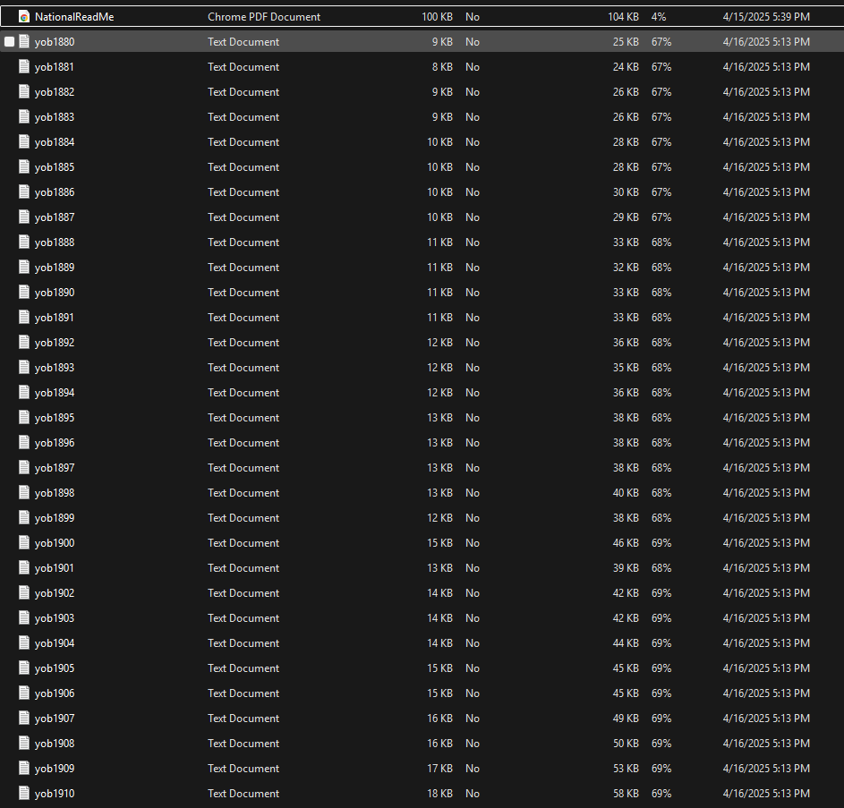
Data and Question Alignment
Dataset breakdown:
Data is split into yearly files (yobYYYY.txt), which contain:
Name
Sex (M/F)
Number of occurrences
Files are sorted by popularity
Only includes names with ≥5 occurrences
Time range: 1880 to present
Notes:
Chris

Slide 10
Data and Question Alignment - Table
Question | Data Used | Can Answer?
How do individual baby names differ in their rise, peak, and decline patterns over time? | Name, year, number/count | Yes
How do popularity trends differ between male and female names? | Sex, name, year, number/count | Yes
How has the distribution of baby names changed over time? | Year, total births, top 10 name counts, number of unique names | Yes
What does past trend data suggest about a name’s future popularity? | Name, year, number/count, year-to-year change, trend slope | Yes
What patterns show when names decline and later return in popularity? | Name, year, number/count, gaps in popularity, multiple peaks | Yes

Slide 11
Most Promising/Interesting Questions
1. How do individual baby names differ in their rise, peak, and decline patterns over time?
2. How has the distribution of baby names changed over time?
3. What does past trend data suggest about a name’s future popularity?
Notes:
XXXXXX

Slide 12
How do individual baby names differ in their rise, peak, and decline patterns over time?
Metrics:
Yearly name count
Year-to-year change
Percent growth rate
Peak year and peak count
Tools / Python Packages:
Pandas
Numpy
Matplotlib
Plots / Visualization:
Line graph (Year vs Name Count)
Smoothed trend line (moving average)
Highlight peak points

Slide 13
How has the distribution of baby names changed over time?
Metrics:
Top 10 Share
births with top 10 names / total births
Number of unique names per year
Total births per year
Tools / Python Packages:
Pandas
Numpy
Matplotlib
Plots / Visualization:
Line graph: Year vs Top 10 Share
Line graph: Year vs Number of Unique Names

Slide 14
What does past trend data suggest about a name’s future popularity?
Metrics:
Recent growth rate
Moving average
Trend slope
Predicted direction: increasing, decreasing, or stable
Tools / Python Packages:
Pandas
Numpy
Matplotlib
Plots / Visualization:
Line graph: Year vs Name Count
Trend line showing projected direction

Slide 15
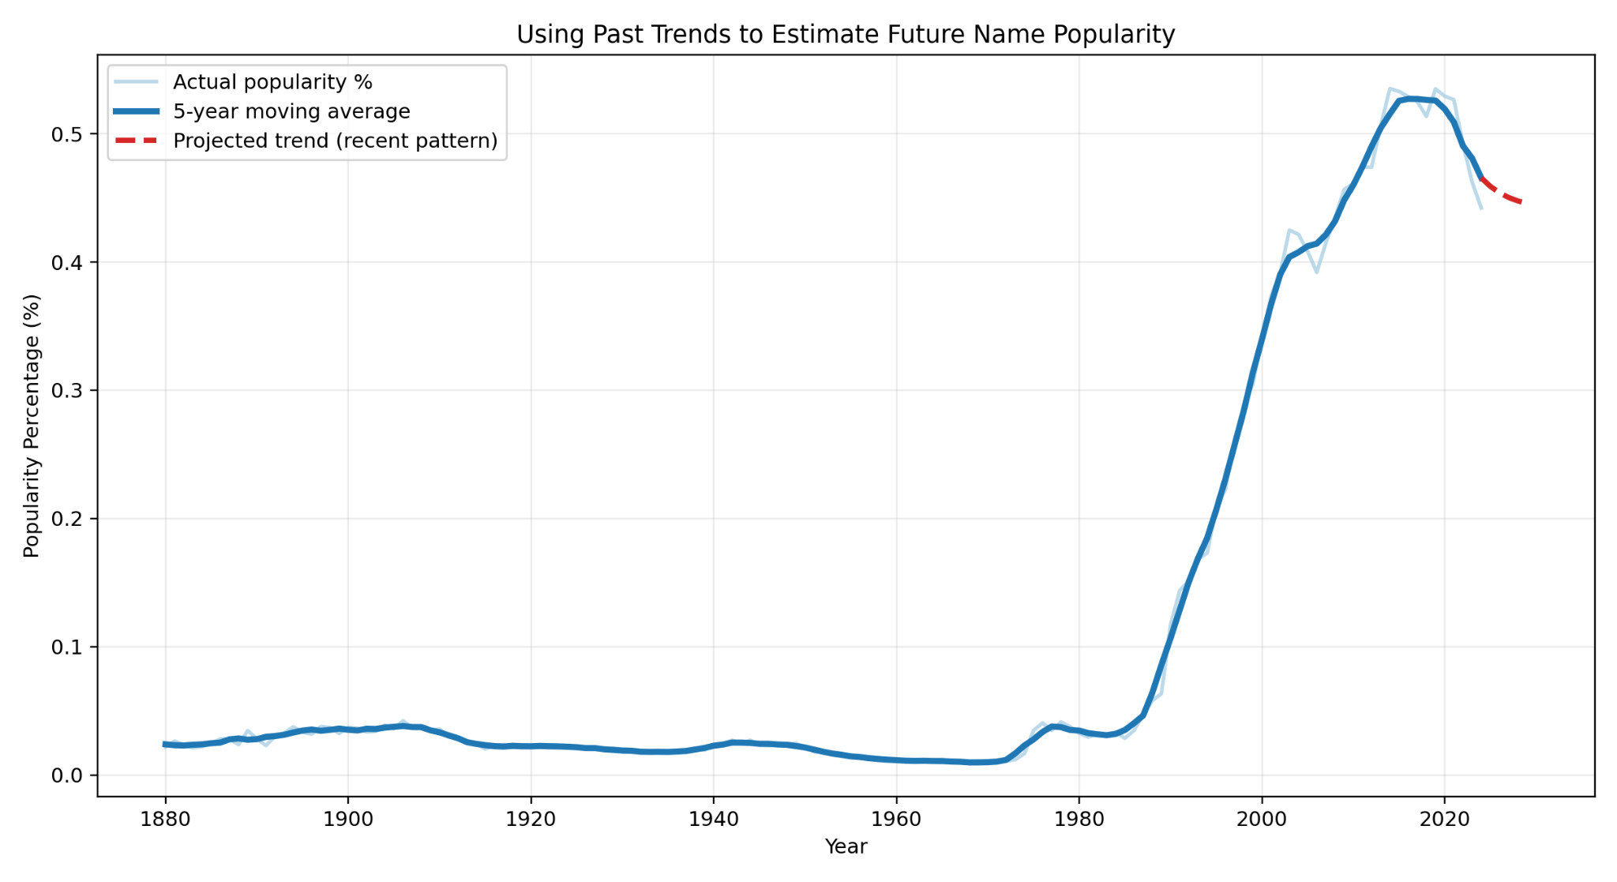
Rough Justification: What does past trend data suggest about a name’s future popularity?
This graph shows Olivia’s popularity as a percentage of total births over time. The moving average smooths the yearly changes, while the projected trend estimates future popularity based on recent patterns. I expect the name to remain popular, but the trend may begin to level off instead of continuing to rise sharply.
Figure 2: Future Prediction
Notes:
philip

Slide 16
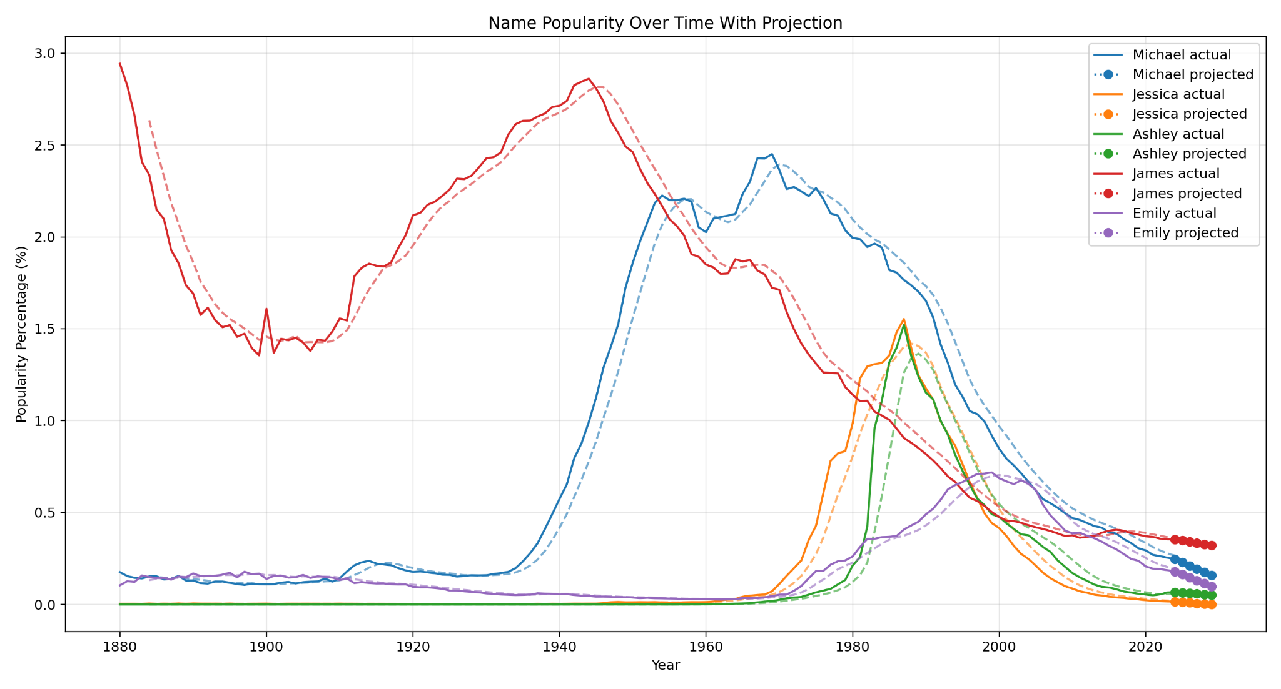
Sketches at Answers: What does past trend data suggest about a name’s future popularity?
Notes:
Philip

Slide 17
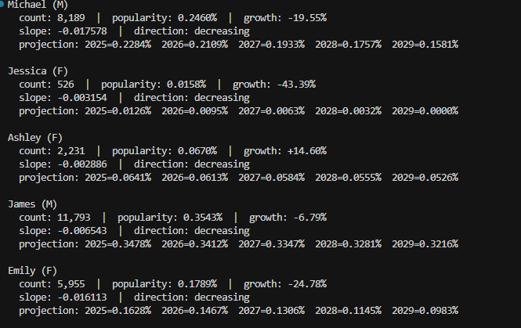
Sketches at Answers: What does past trend data suggest about a name’s future popularity?
Notes:
Philip

Slide 18
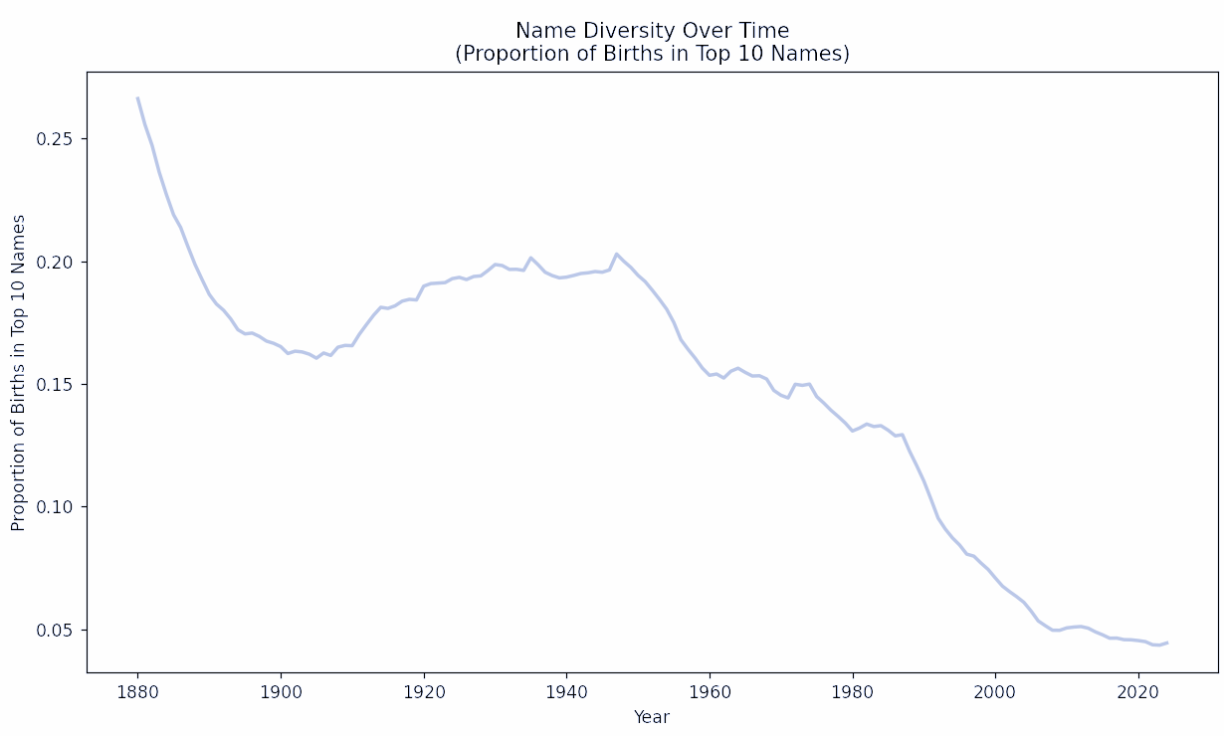
Rough Justification: How has the distribution of baby names changed over time?
A decreasing line over time means names are becoming more diverse, fewer babies are being given the same top 10 names.
Figure 2: Name Diversity Graph
Notes:
chris

Slide 19
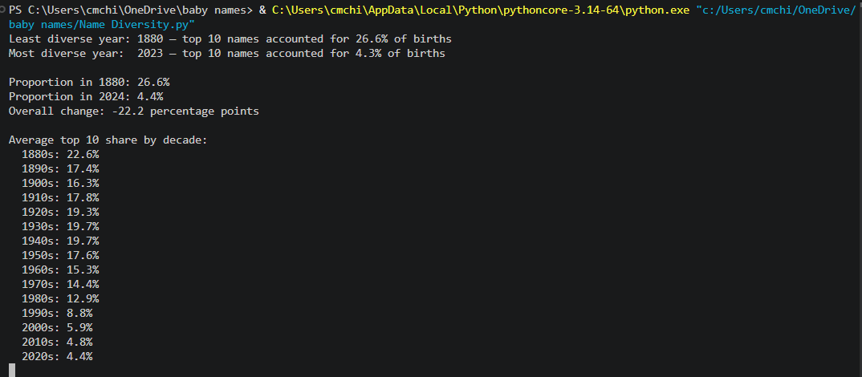
Sketches at Answers: How has the distribution of baby names changed over time?
Notes:
chris

Slide 20
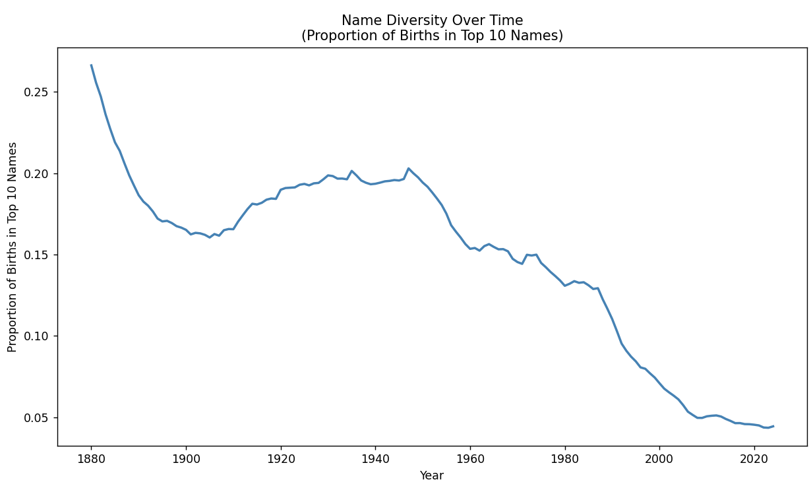
Sketches at Answers: How has the distribution of baby names changed over time?
Notes:
chris

Slide 21
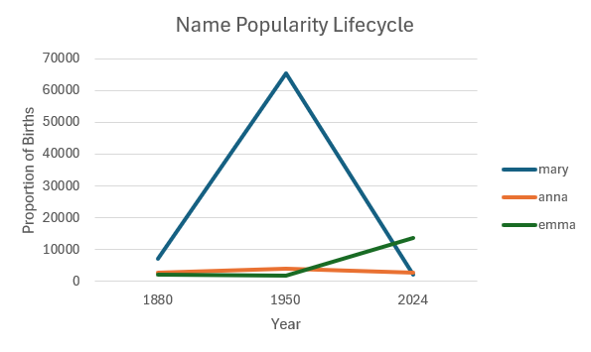
Rough Justification: How do individual baby names differ in their rise, peak, and decline patterns over time?
For this example I took the 3 most popular female names in 1880 and created a rough estimate of how the popularity of their name changed over time.
Figure 1: Example Name Popularity Graph
Notes:
chris

Slide 22
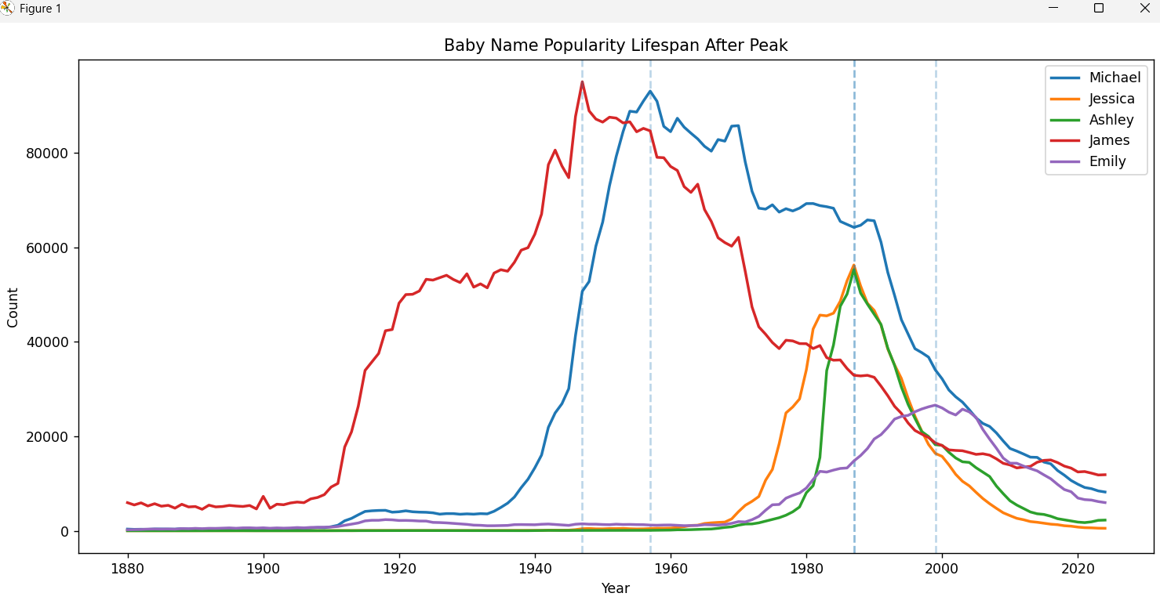
Sketches at Answers: How do individual baby names differ in their rise, peak, and decline patterns over time?
Notes:
chris

Slide 23
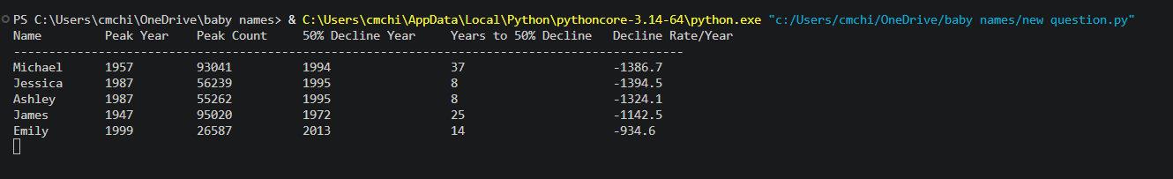
Sketches at Answers: How do individual baby names differ in their rise, peak, and decline patterns over time?
Notes:
chris

Slide 24
Data Decisions: What does past trend data suggest about a name’s future popularity?
Answer found: Yes. All five names analyzed show a decreasing trend. Michael is declining at -19.55% growth rate, Jessica at -43.39%, and James, the slowest, at -6.79%
Expected relationship: It was expected that past trends would continue into the future — the linear projections support this, though the model assumes a straight-line decline which may oversimplify reality
Clear conclusion: Yes — all analyzed names are projected to continue declining in popularity through 2029. James will decline the slowest due to its long cultural staying power, while Jessica is projected to nearly disappear by 2029

Slide 25
Data Decisions: How has the distribution of baby names changed over time?
Answer found: Yes, very clearly. In 1880 the top 10 names accounted for 26.6% of all births. By 2023 that dropped to just 4.3% — a decline of 22.2 percentage points
Expected relationship: It was expected that names would become more diverse over time — this was strongly confirmed
Clear conclusion: Yes — name diversity has increased consistently every decade, with the sharpest drop occurring after the 1950s. Parents today choose from a far wider range of names than in previous generations

Slide 26
Data Decisions: How do individual baby names differ in their rise, peak, and decline patterns over time?
Answer found: Yes, names differ significantly in their life cycle patterns. Michael peaked in 1957 at 93,041 births and took 37 years to decline 50%, while Jessica and Ashley both peaked in 1987 and declined within just 8 years despite similar peak counts
Expected relationship: It was expected that higher peak counts would mean longer lifespans — this was partially confirmed by Michael and James, but Ashley and Jessica contradicted this
Clear conclusion: Yes — names that peaked in earlier decades (pre-1960s) tend to have much longer popularity lifespans than names that peaked in the 1980s-90s, suggesting cultural naming trends have accelerated over time

Slide 27
Reflection of Process
Working with 145 real-world data files was more challenging than expected — issues like file paths, column names, and encoding problems had to be solved before any analysis could begin
The most surprising finding was that names peaking in the 1980s declined much faster than older names, which was not the initial expectation
This process showed that data rarely behaves exactly as expected — Ashley and Jessica had similar peak counts to Michael but completely different lifespans, proving that raw numbers alone don't tell the whole story
If starting over, more names across different eras would be included to make the conclusions more generalizable, and a non-linear model might better capture the natural rise and fall of name trends
Notes:
Haden

Slide 28
Reflection of Personal Growth
At the start of this course, working with real datasets and writing Python scripts felt overwhelming. Debugging file path errors and fixing column name mismatches were frustrating at first but built real problem-solving skills
The biggest growth was learning to not just write code that runs, but to think critically about what the results actually mean and whether they answer the original question
Study habits improved by breaking large problems into smaller steps rather than trying to solve everything at once
The baby names dataset was engaging because it connected to real cultural patterns, making the analysis feel meaningful rather than abstract
Notes:
Haden

